Slide 1

السلام عليكم

Slide 2

Mazen
Saad
Computer teacher

Slide 3
ICT
Grade 5

Slide 4

Enter the notebook and write the following:

Slide 5
Lesson title
Computer Around Us
The Date
2025 / 9 /

Slide 9
Start

Slide 10
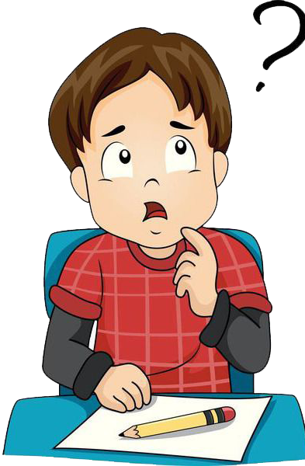
Do you know what Bytes are?

Slide 11





Slide 13


Slide 14

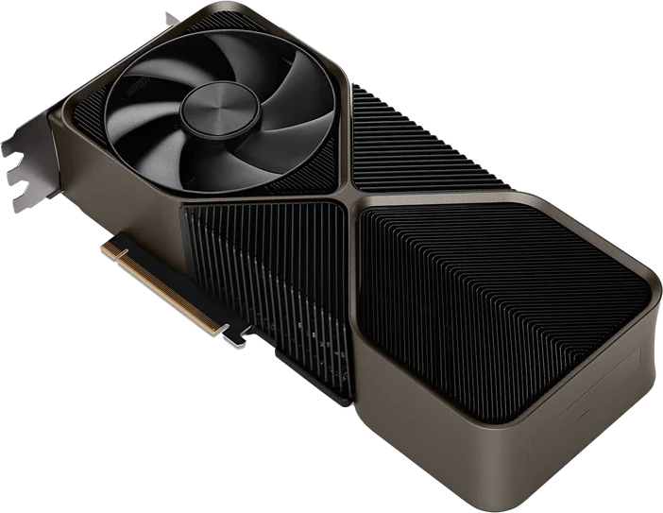
6- The full form of GPU is ______________

Slide 15
6- The full form of GPU is Graphics Processing Unit

Slide 17
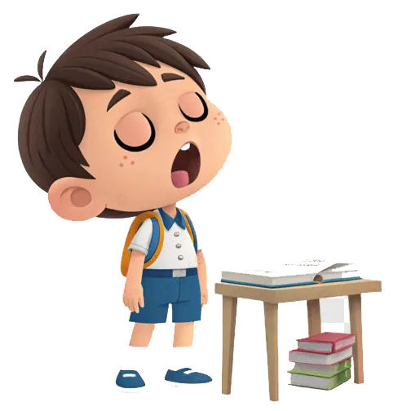
We follow the explanation
Yes Or No

Slide 18


Slide 20
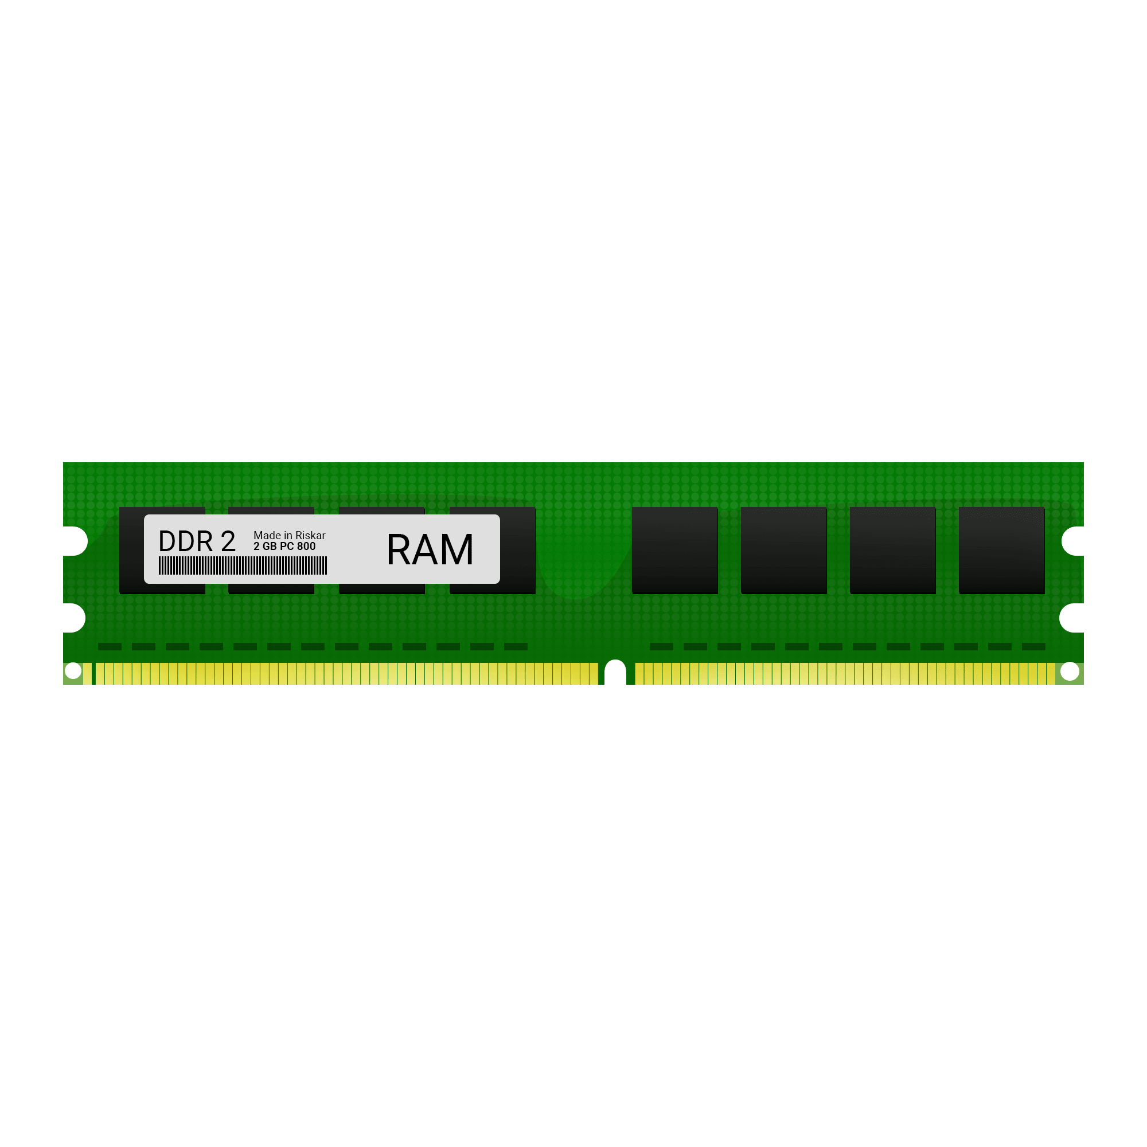
5- RAM (Random access memory)

Slide 21

Do you know what GPU are?

Slide 22
6- GPU (Graphics Processing Unit).

Slide 23
7- When a new program stats on the computer, its information is stored in the RAM.

Slide 24
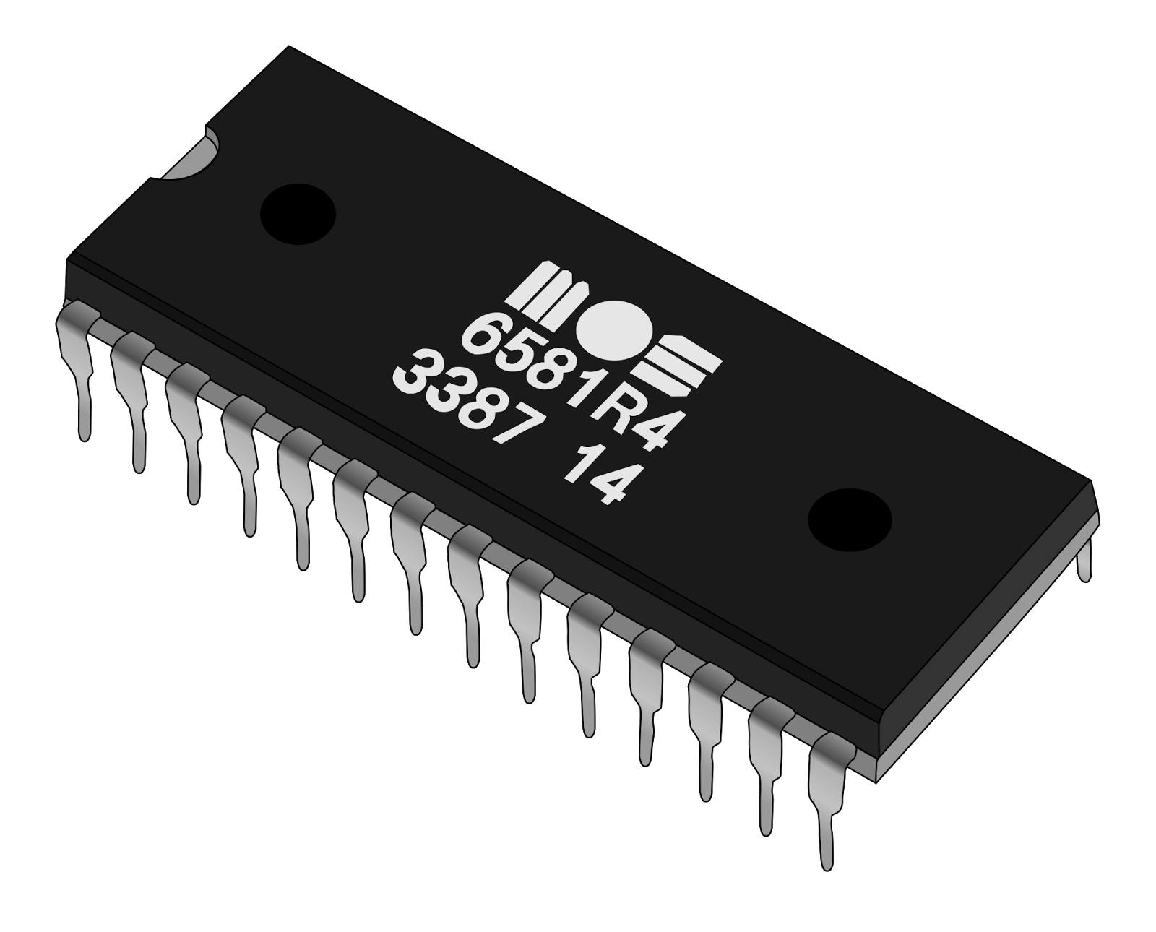
9- Rom is the permanent memory that stores read only data.

Slide 25
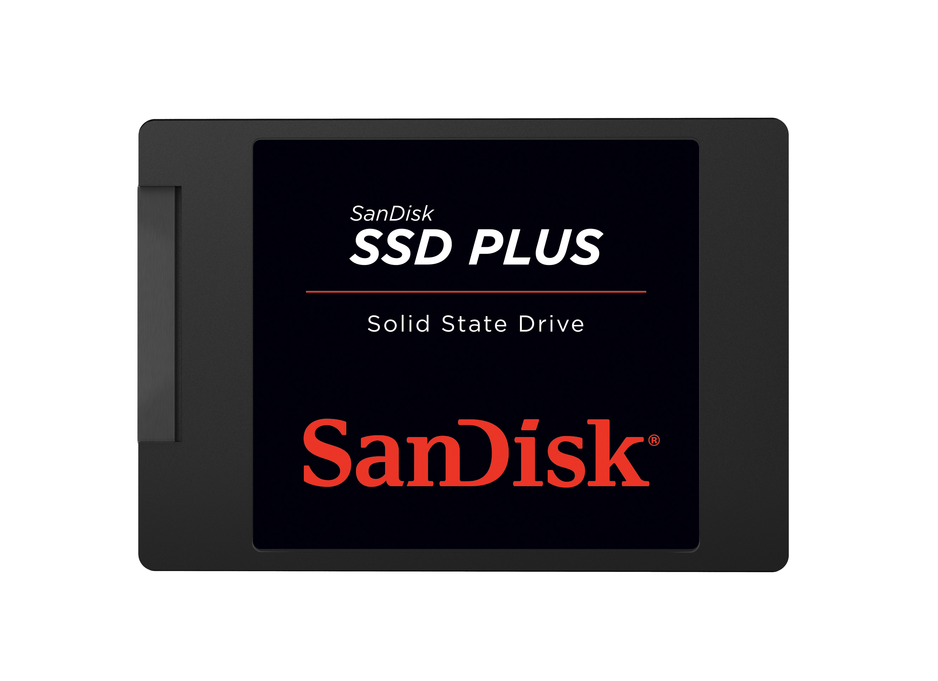
10- (SSD) the speed to read and write data is faster than HDD.

Slide 26
11- GPU helps us play high definition Video games and make computer animations and drawings.

Slide 27

Exercise

Slide 28

Page Number 04

Slide 29
______________ do not run applications like smart watches.

Slide 30
Fitness bands do not run applications like smart watches.

Slide 31
…………………… helps us to identify products and find reviews.

Slide 32
Smart glasses helps us to identify products and find reviews.

Slide 33
We follow the explanation
Yes Or No

Slide 34
True/False

Slide 35
Fitness band track a user’s activity

Slide 36
Fitness band track a user’s activity True

Slide 37
A smart TV can be used to search the web

Slide 38
A smart TV can be used to search the web True

Slide 39

Smart watches come packaged with virtual assistants.

Slide 40
Smart watches come packaged with virtual assistants. Fales

Slide 41
Page Number 06

Slide 42
Smart speakers are sometimes called

Slide 43
Smart speakers are sometimes called Home Assistants

Slide 44
help futuristic cars avoid collisions.

Slide 45
Proximity sensors help futuristic cars avoid collisions.

Slide 46
cars are controlled by artificial intelligence.

Slide 47
Self-driving cars are controlled by artificial intelligence.

Slide 48

Homework

Slide 49
Page Number 06

Slide 50
Page Number 11

Slide 51
Homework

Slide 52
Page Number 12

Slide 53

Thank you for everything

Slide 54
السلام عليكم

